Slide 1
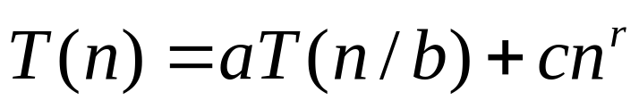
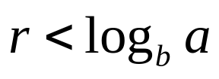
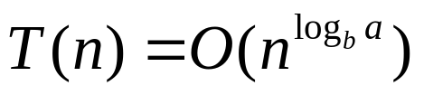
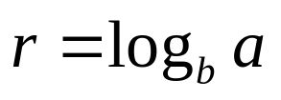
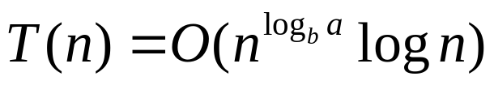

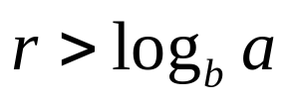
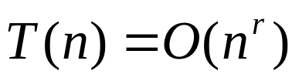
Simplified Master Theorem
Let Then,
1. If , then
(The main cost is the bottom layers region)
2. If , then
(Every layer has roughly the same cost)
3. If , then
(The main cost is the top layers region)
Growth of Functions
1

Slide 2
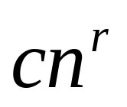


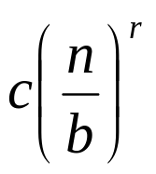

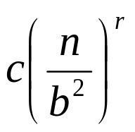

Layers
Layer
Growth of Functions

Slide 3

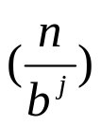
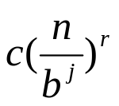
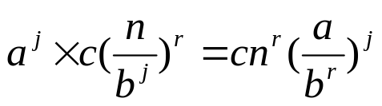
Proof.
The number of nodes in the j-th layer is
The size of a node in the j-the layer is
The cost of each node in the j-th layer is
The total cost at j-th layer is
Growth of Functions

Slide 4
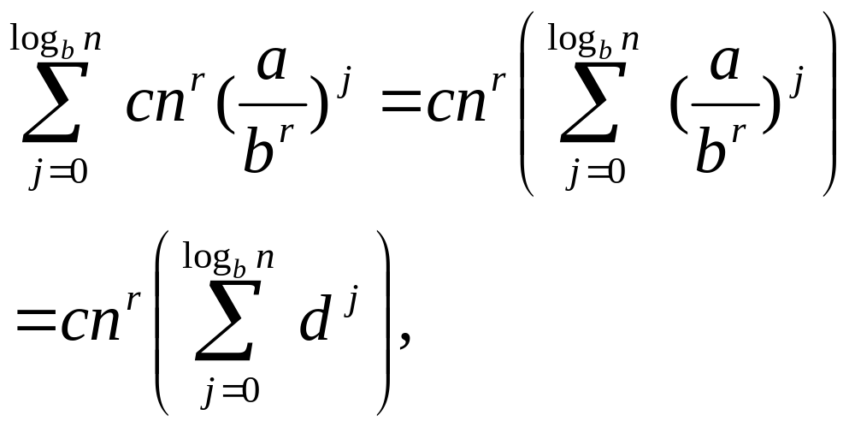
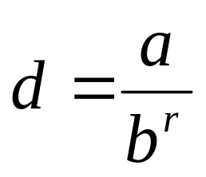
Proof.
The total cost at all layers is
Where d is the constant
Growth of Functions

Slide 5
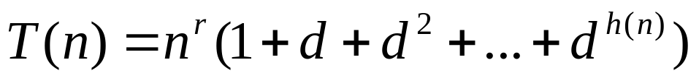
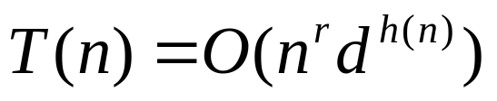
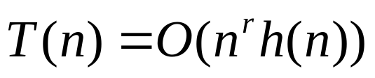

Order
Assume that d, r are constants.
Case 1: d>1.
Case 2: d=1.
Case 3: d<1.
Growth of Functions

Slide 6
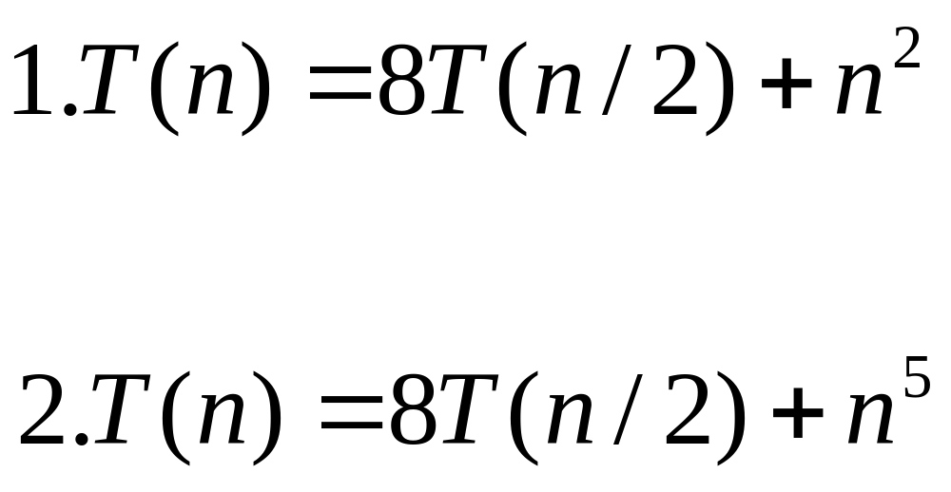
Exercise
Solve the following two equations with the simplified master theorem . Also identify the main cost region.
Growth of Functions

